Slide 1
Effects of external factors on bicycle station balance
Team 7: Qianyu chen, Boxuan Chen, Tong Wu, Caleb Okoh-Aihe

Slide 2
Table of Content
Motivation
Objectives and Deliverables
Data Sources
Key Tools and Services
Architecture

Slide 3
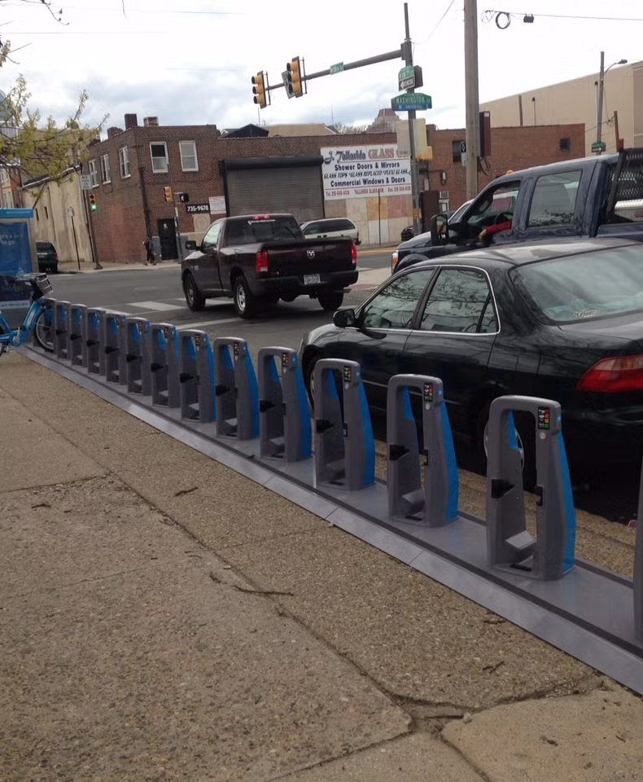

Motivation
The City of Philadelphia in partnership with Qucit algorithmically attempt to ensure city-wide bike availability via their bike share program, Indego. However, many station are regularly empty as their current algorithm fails to account for changes in commuter habits due to commuting patterns, weather, sporting events and road closures. This project attempts to see how these factors affect bicycle availability at stations.

Slide 4
Objectives and Deliverables
Determine the effects of weather, commuter patterns and street closures on Bike Balance across the City
Create an interactive tool to demonstrate the effects of these external factors Bike Balance
Notes:
The word ”tool” is doing a lot of heavy lifting here. It will be a Web App that displays live information of stations around the city at risk of being empty and which factors are at play.

Slide 5
Data Sources
Source | Details
Indego Trip Data | Historical and live data in a CSV format, provides station demand, turnover and departure information
Open Meteo Weather API | Historical and live Weather data with geographical details
Street Closure Data | Historical and live information on street closures that can be layered with the position of bike stations.
Notes:
Indego trip data is public, unfortunately, it does not contain historical information of station capacity. It does however, contain historical information of returns and checkout so we can compute a flowrate for each station
Schema should be included as well.
INclude thesource as wlwe

Slide 6
Key Tools and Services
Kafka: Live Data from API’s is published to its own topic
Apache Spark: Parses Ingested Kafka Streams and derives usable metrics
Hadoop: Distributed storage for historical and streaming data
Vue3: Composable SPA Frameworks to create interactive visualization of results.
Notes:
Spark : Cleans,, get relevant metrics out of the data, Faster than Hadoop MapReduce but I am open to changes
Hadoops Distributed File Systsem

Slide 7
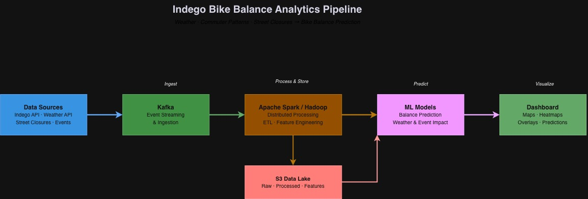
Architecture
Notes:
Kafka Topics
Hadoop: Allows Us to Store our processed
The model performs inference, using pretrained data to predict
Ingest – Collect live bike, weather, and street closure data.
Process & Store – Clean, combine, and store data for analysis.
Predict – Use historical patterns to forecast bike availability.
Visualize – Present insights through an interactive dashboard.
Include AWS abstractions on like how does Hadoop exist in AWs, how is ML trained in AWS
Split intoi One for bath and one for real time

